Slide 1
Syntax Squad

Slide 2
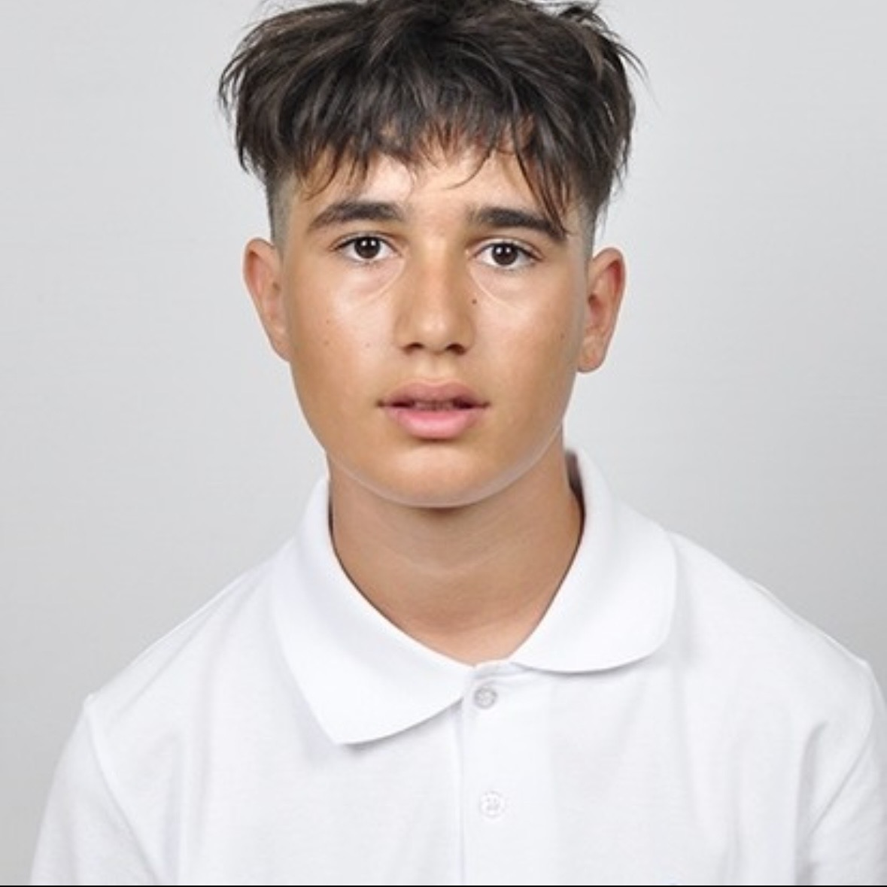
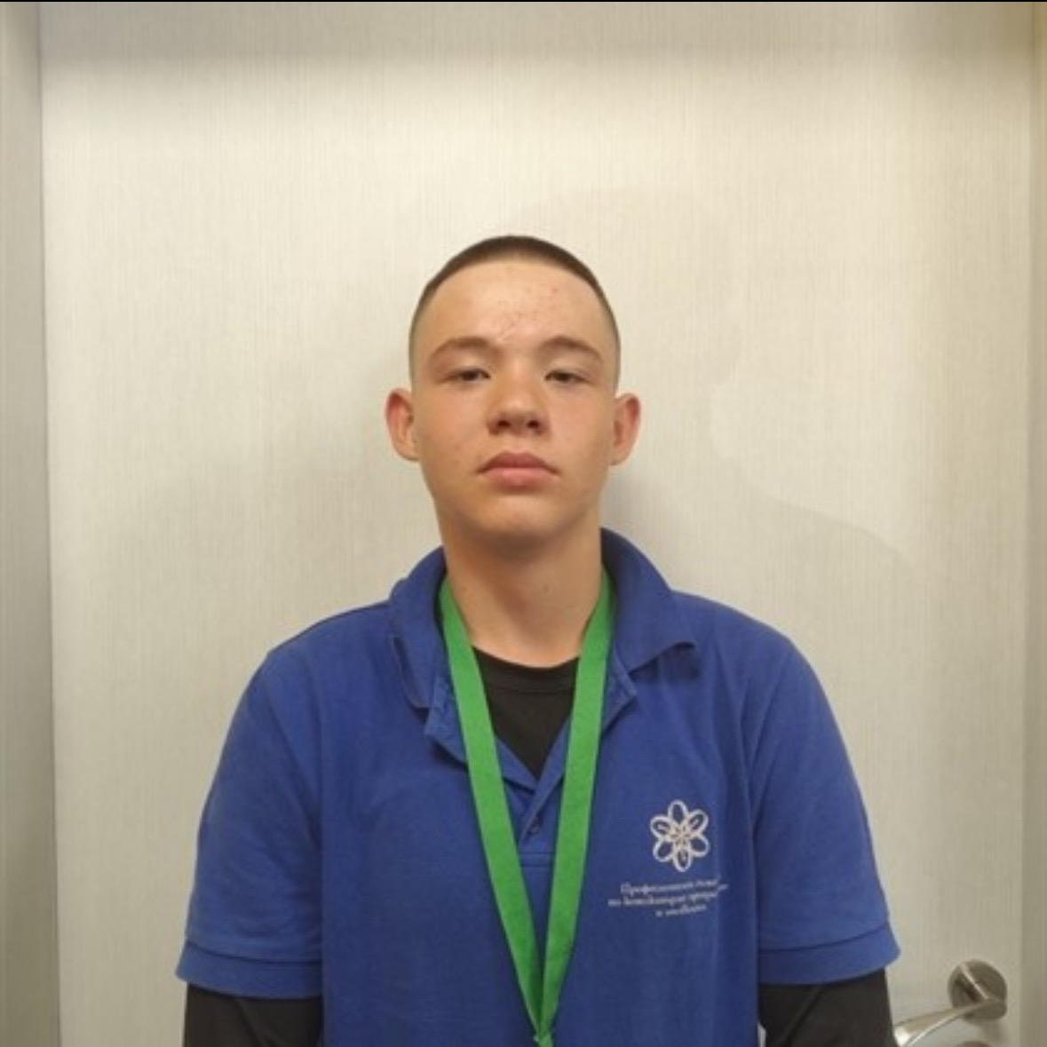
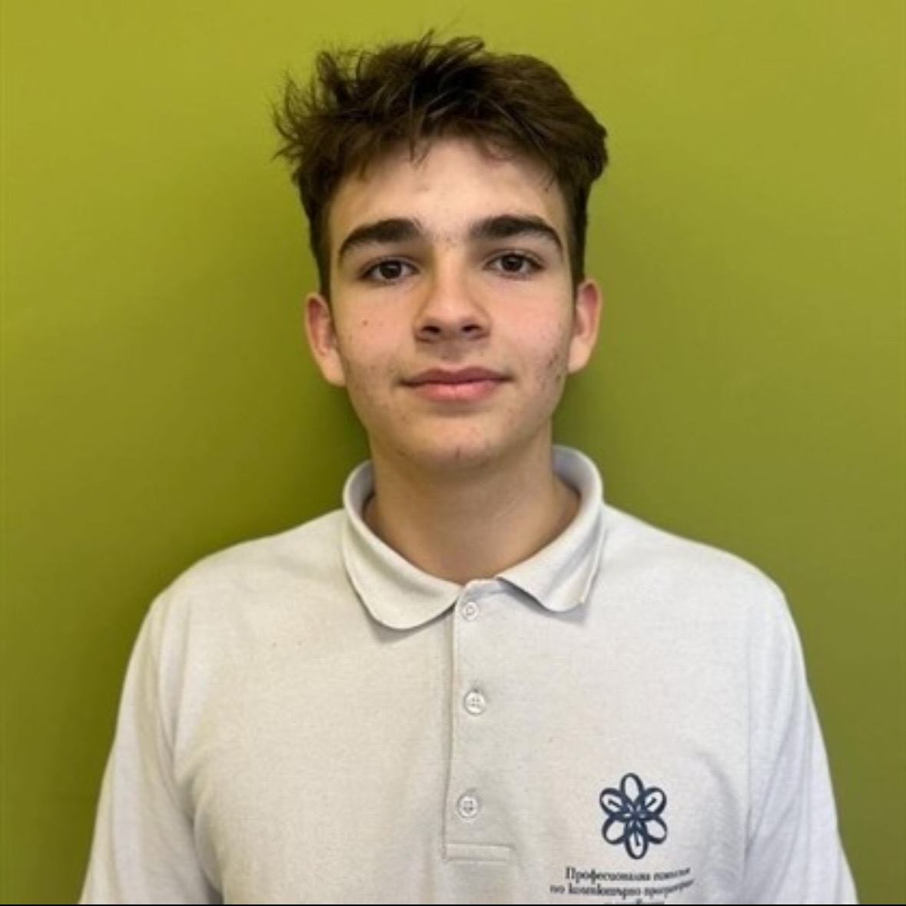
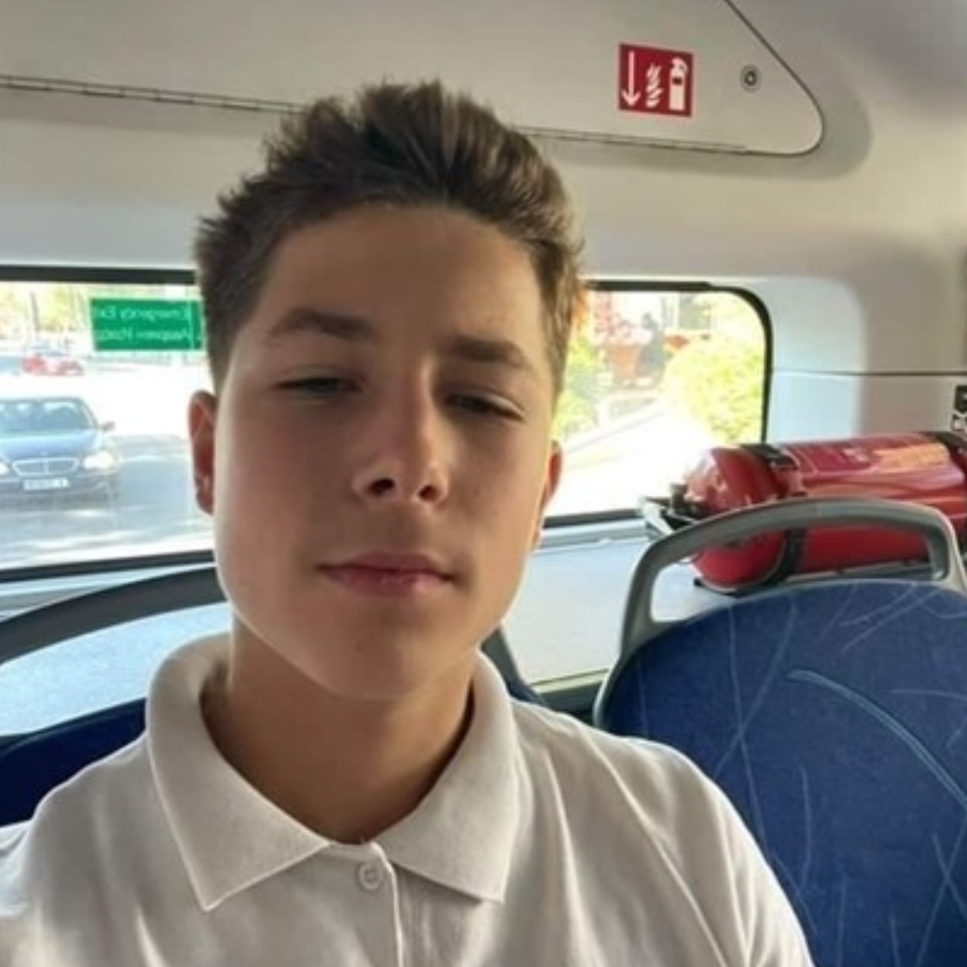
Our Team
Back-end developer:
Doni Dimitrov
Scrum trainer:
Stilian Solinkov
Front end developer:
Alexander Petrov
Designer:
Kaloyan Koev

Slide 3





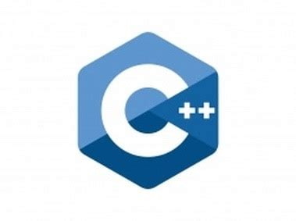


Used technologies

Slide 4
Lets review the code

